Slide 1
Midterm Proposal
Jane Kim

Slide 2
Website Description
Website name:
Lost Angeles
Description:
Lost Angeles is a travel guide website for people traveling to Los Angeles. It will include articles involving food and activities. The food and activities will come from three major neighborhoods of Los Angeles.

Slide 3
Site Map

Slide 4
Wireframe: Home

Slide 5
Wireframe: Log In

Slide 6
Wireframe: Sign Up

Slide 7
Wireframe: Food

Slide 8
Wireframe: Activities

Slide 9
Wireframe: Neighborhoods

Slide 10
Wireframe: Silver Lake

Slide 11
Wireframe: Larchmont Village

Slide 12
Wireframe: Santa Monica

Slide 13
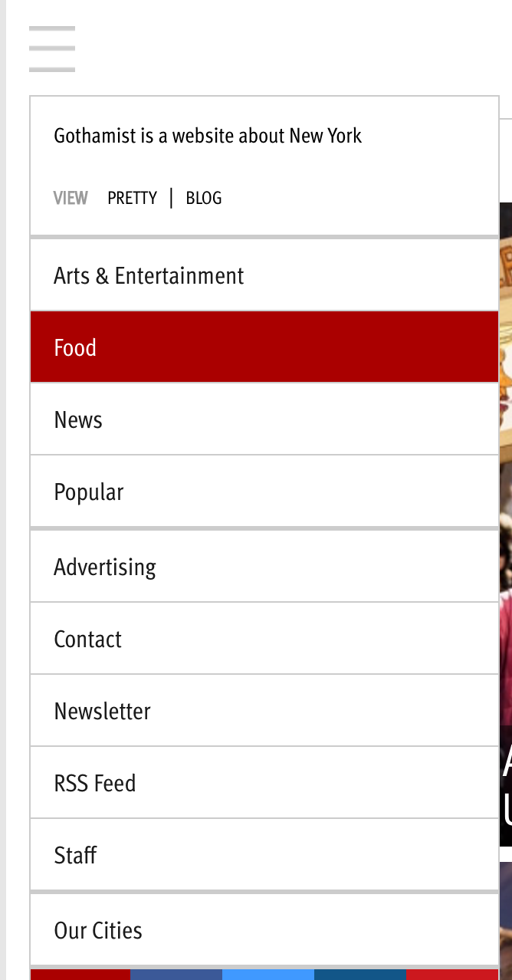
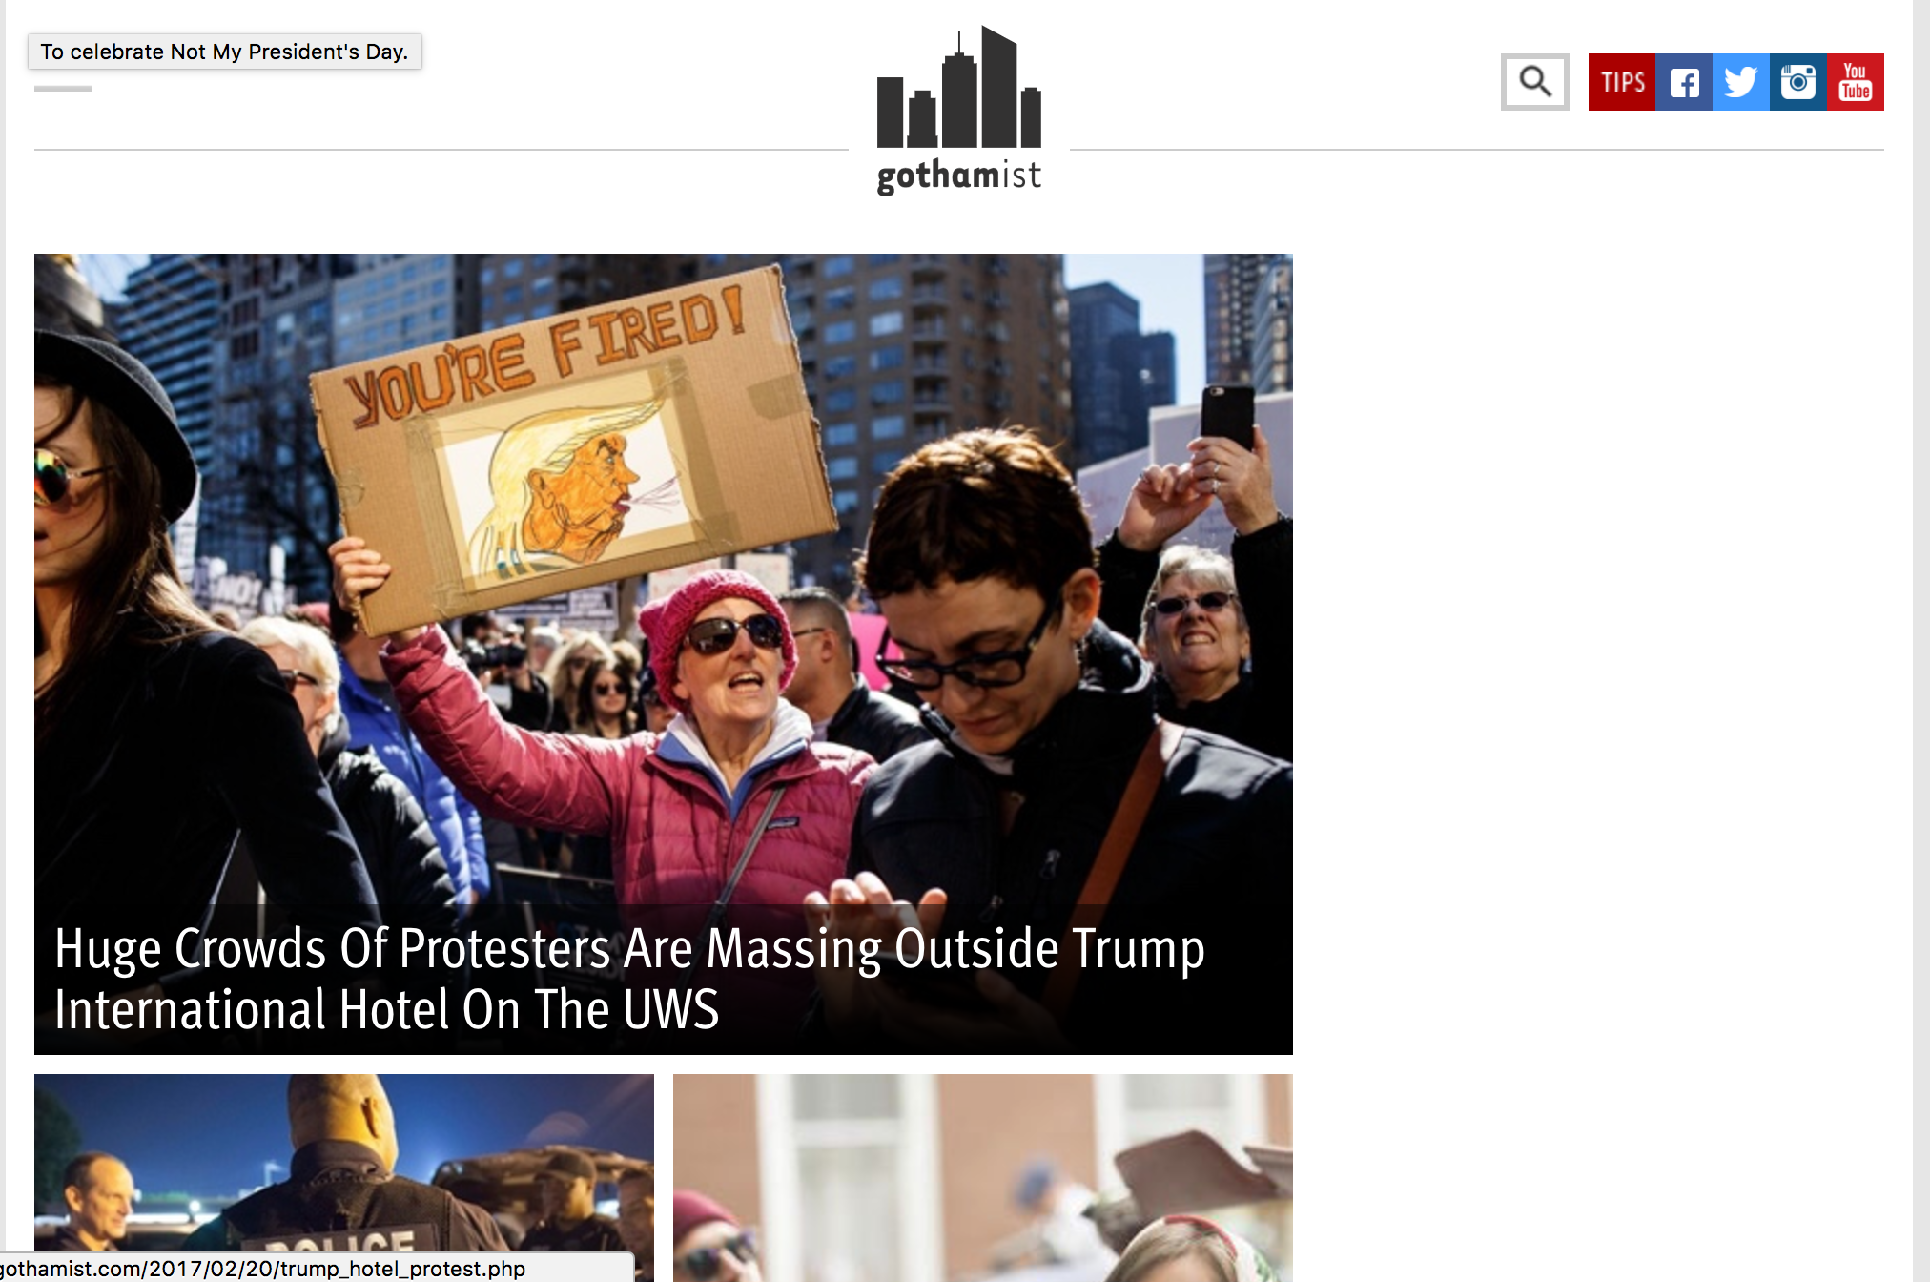
Website I have drawn inspiration from : Gothamist

Slide 14
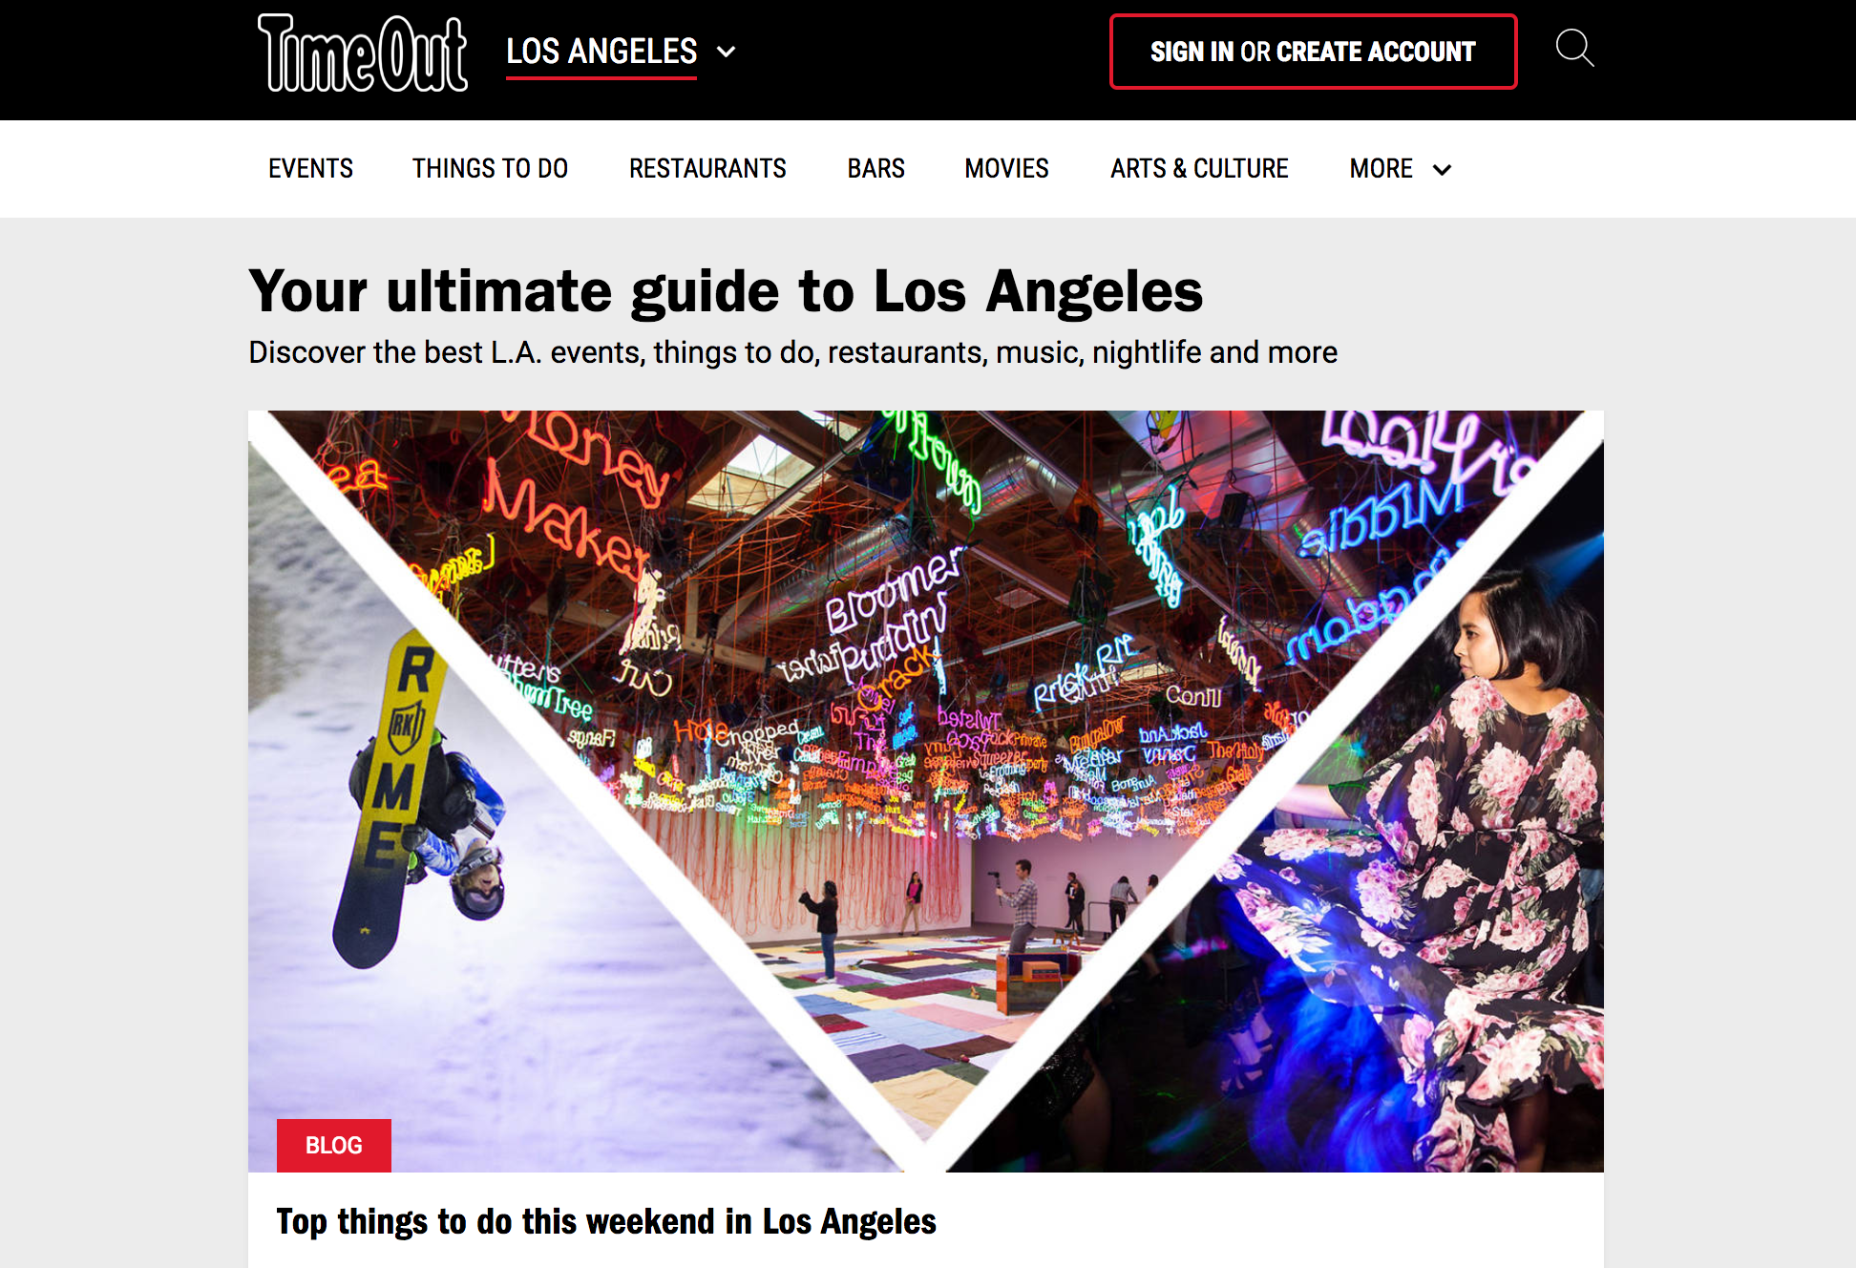
Website I have drawn inspiration from: Timeout

Slide 15
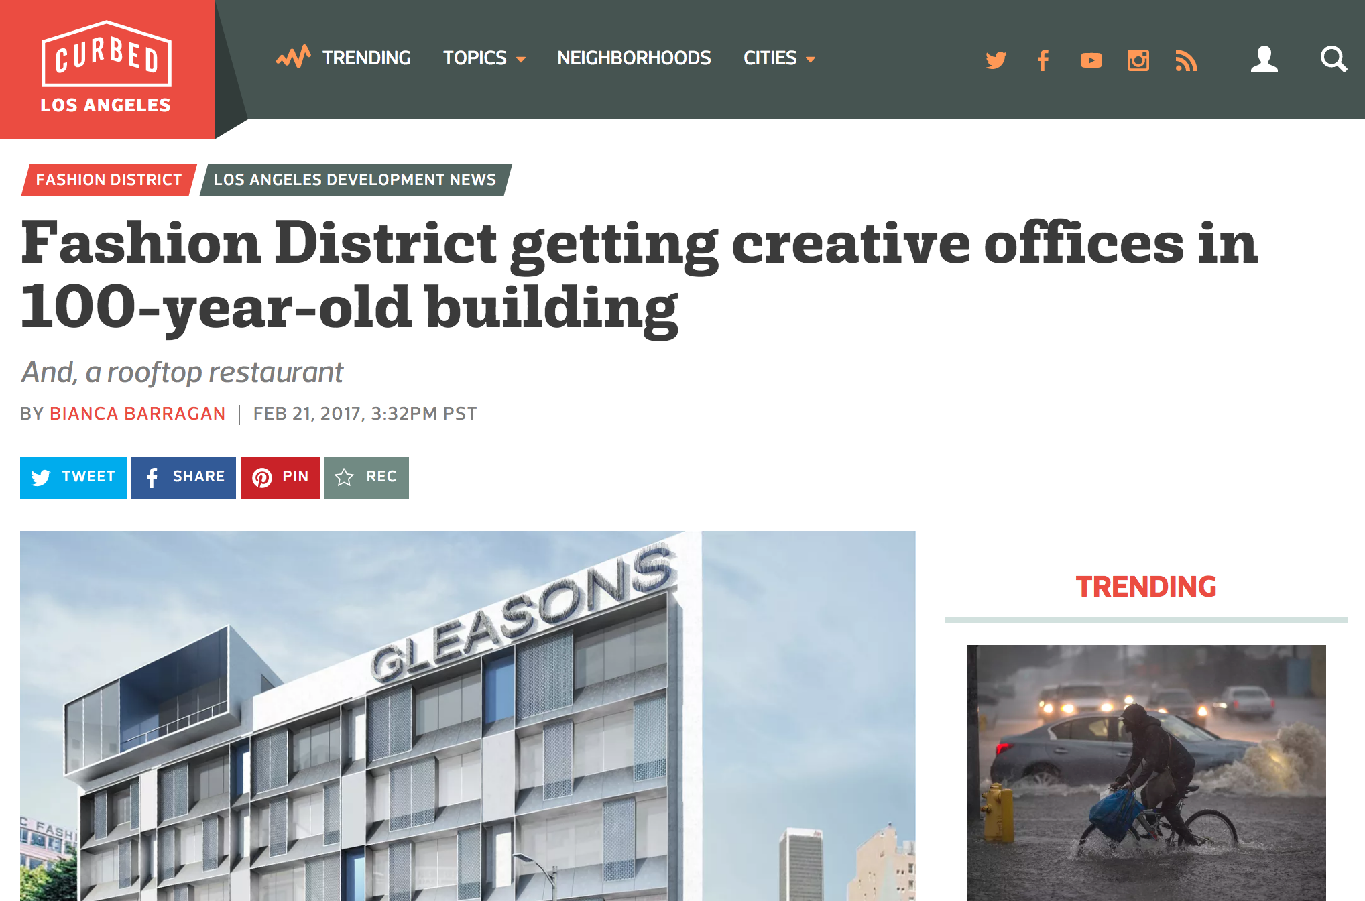
Website I have drawn inspiration from: Curbed

Slide 16
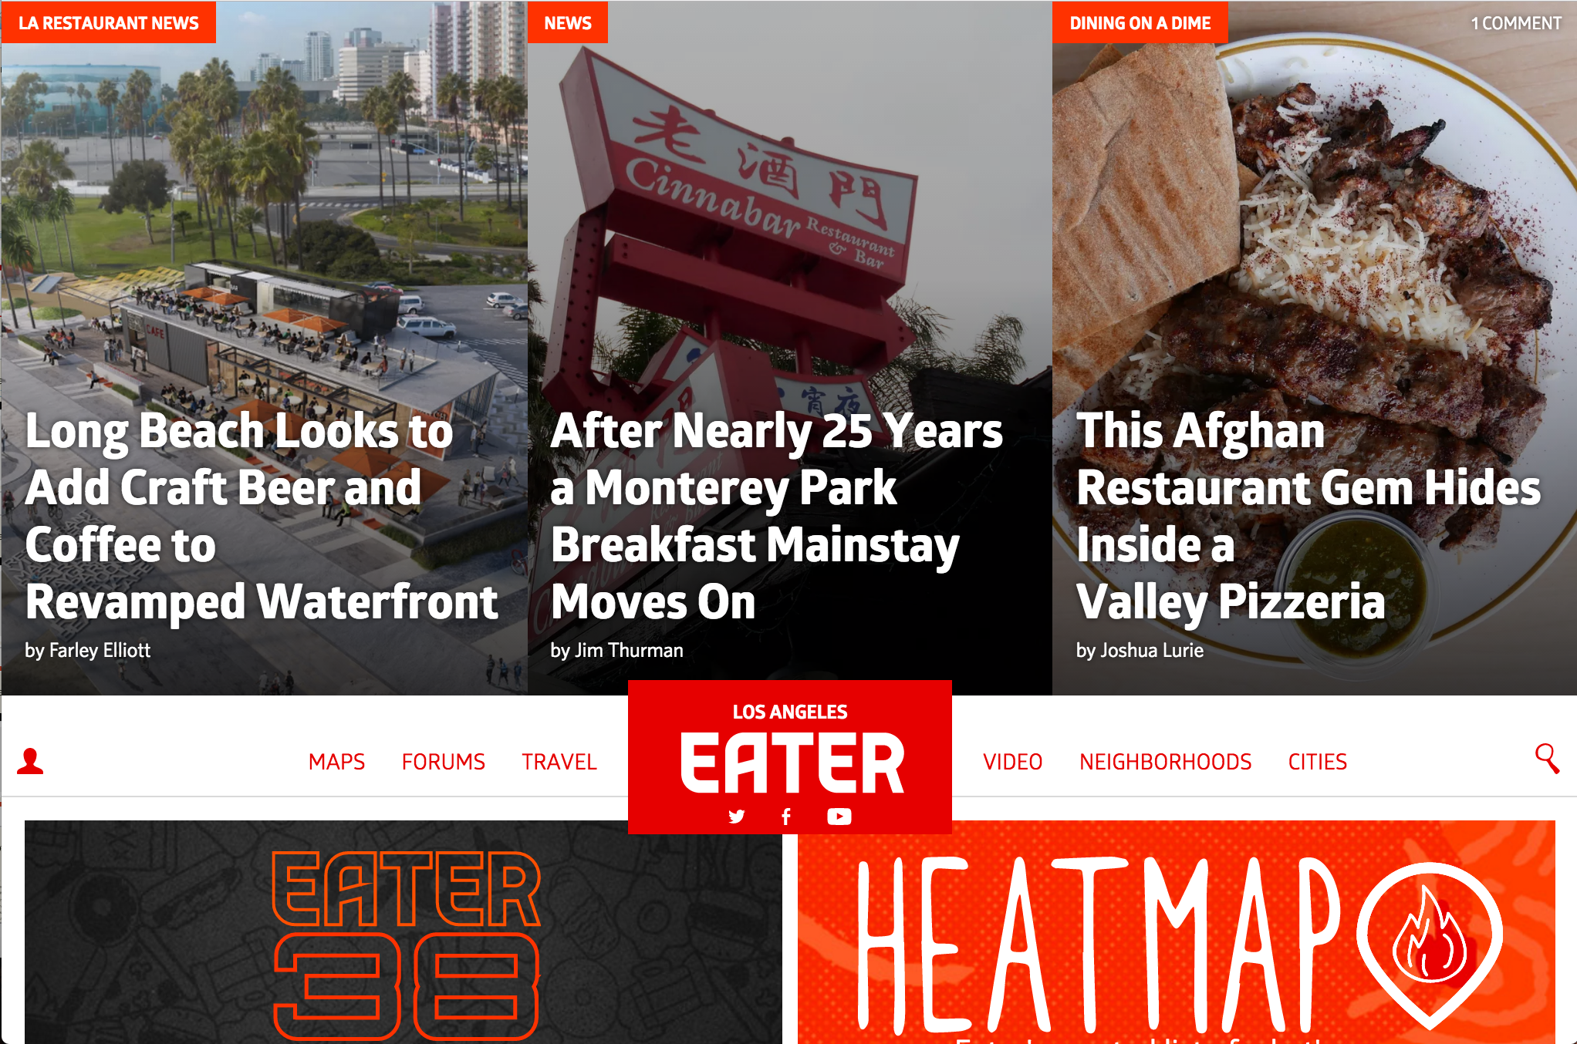
Website I have drawn inspiration from: Eater

Slide 17
Concepts I have learned:
Navigation bar
Inline Block (to position my blocks of text)
Positioning (Fixed header)
Div (to group different sections)
Container (to group different sections together)
Change background color or image/pattern
Change font/using Google font
Add images to a website
Create multiple pages for a website
Add icons and images with icons

Slide 18
Concepts I will need to learn:
Use icons instead of text to link
Create opacity when hovering over
Opacity and text in front of images

